Slide 1
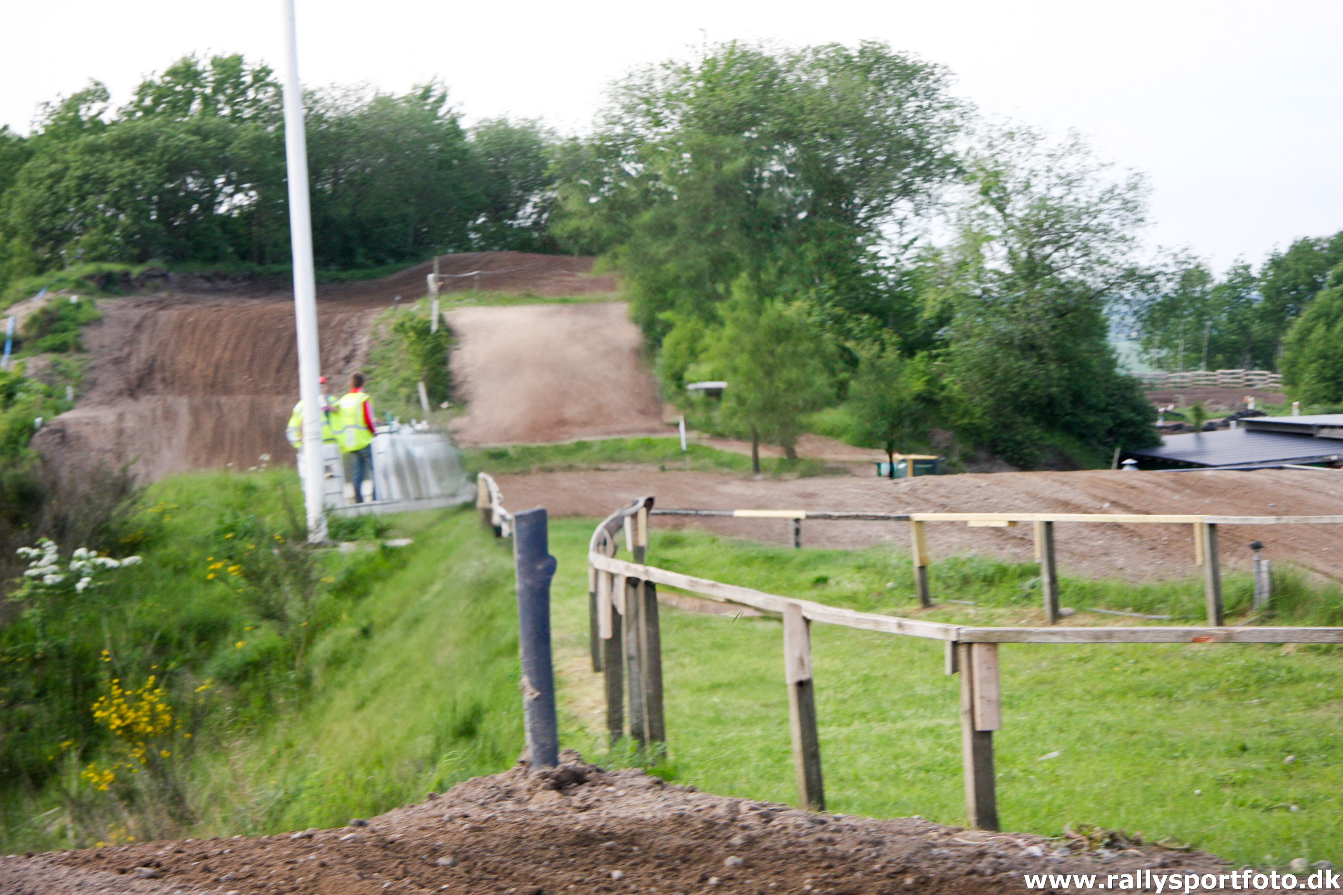
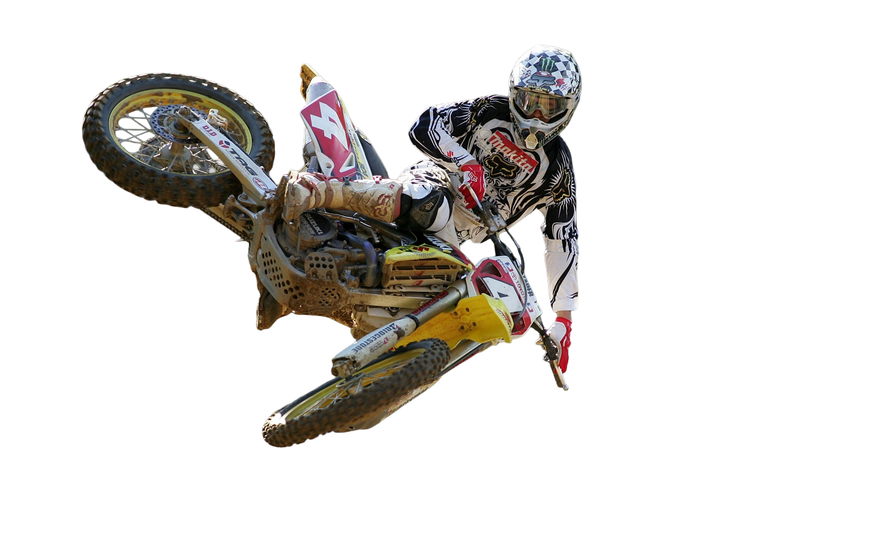

CEMAR 2
Classic Motocross + classic 50cc pre83 cup
June 13, 2026 – DALL RACEWAY, DK
NEW
EVO PRE-08 CLASS
Gate open from Friday 12/6 kl 12:00.
Registration and technical approval Friday 17:00-19:00 & Saturday 7:00-8:20
Clubhouse cafeteria open Friday & Saturday for burgers, sausages, fries etc. Breakfast rolls can be ordered Friday before 19:00 for Saturday morning
Overnighting only in lower car park..
Track direction GPS : 56.968700, 9.892220 / 56°58'07.3"N 9°53'32.0"E
NOTE - Only riders holding valid FIM license can start
ENTRY - https://almk.nemtilmeld.dk/10/ ….. and more usefull information

